Slide 1
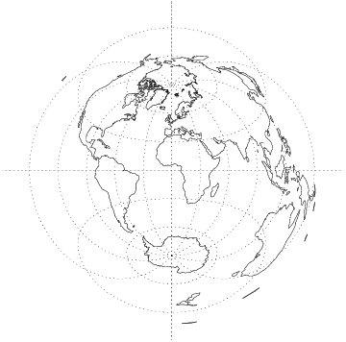
Mapping Resources
Developed by Rachael Dottle

Slide 2
EMPIRICAL REASONING CENTER
•Who are we?
•How can we help?
•Where can you find us?

Slide 3
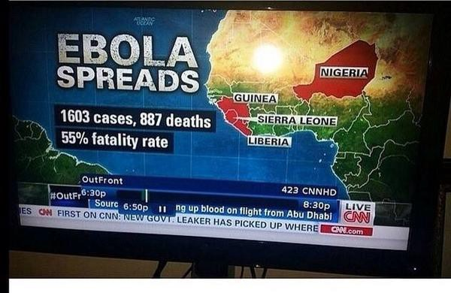
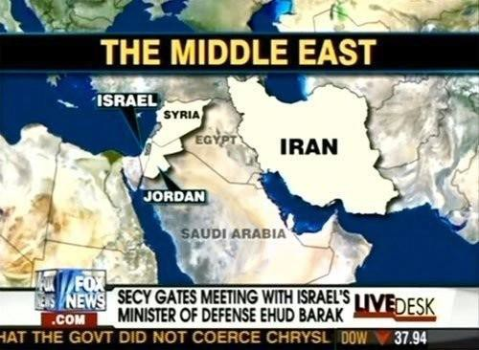
WHY DO MAPS MATTER
Knowledge is power.
http://www.antievictionmap.com/

Slide 4
What kinds of data/information are
displayed on maps?

Slide 5
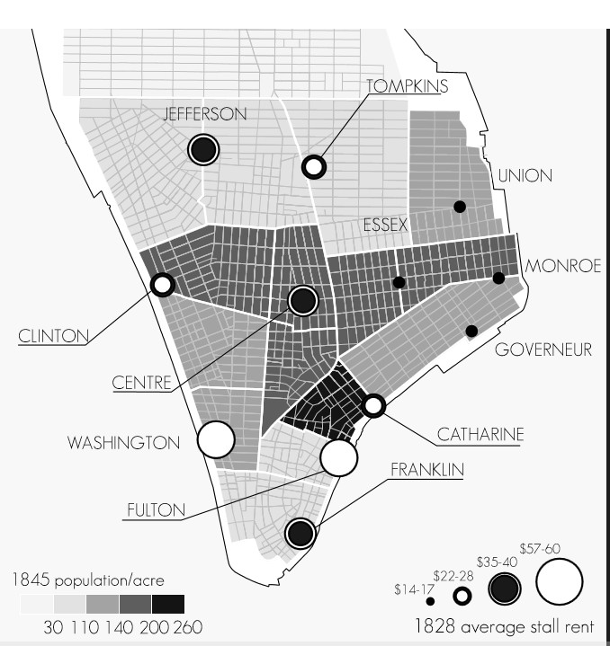
POPULATION DENSITY
(NUMBER OF PEOPLE PER ACRE)
POINT LOCATIONS OF MARKETS
AVERAGE RENT OF THE THE MARKET.
TAKEAWAYS –
DIPSPLAY DATA THROUGH COLOR VARIATION AS POLYGONS, POINTS, AND BY ADJUSTING THE SIZE OF DIFFERENT POINTS PROPORTIONALLY.

Slide 6
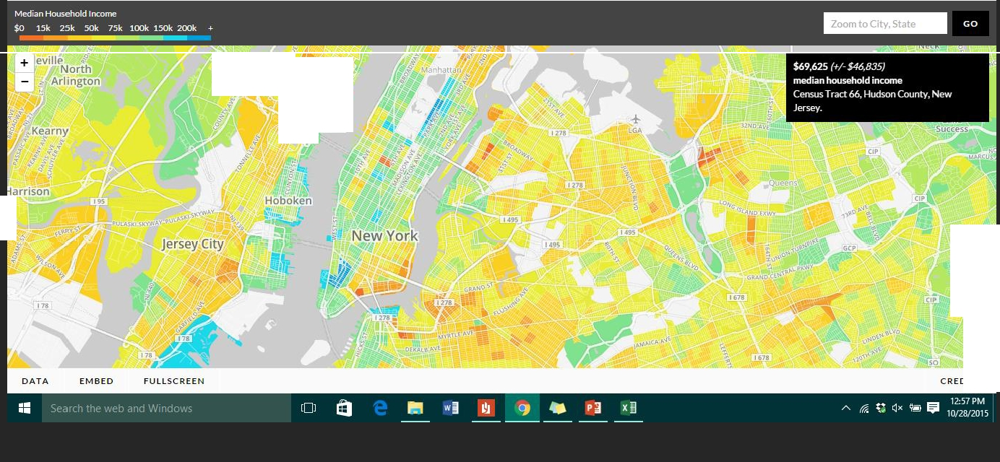
mam Median Income Across the US
f
Explore the median household incomes in neighborhoods across the Unite.d States,based on the latest U.S. Census Bureau data.
Q'
Secaucus
,, West New
York
tJnion Cit,.
$
.,,
,·
"
Weehawken
k
Floralj,P.a
CR E DI TS

Slide 7
HOW TO GET STARTED
• SOCIAL EXPLORER – gives you access to Census, American Community Survey, historical data, economic data…
• CARTODB – allows you to upload your own data,
create interactive maps.

Slide 8
· .,. •
HOME
A1 Cut
INSERT
PAGE LAYOUT
FORMULAS
·IA. A•
DATA
REVIEW
·
ts '!
VIEW
.,,,
=
m
lcalibri
= = =
Wrap Text
IGeneral
• $ • %
·I
@
..=
L AutoSum
Ii]Fill •
Clear •
[jif Copy •
Paste
· = = =
r,,
EE
Insert
Format Painter
B I .!!. •
;··;"! ..
·
Merge & Center
f-.0 .00
.00 -+.0
Conditional Format as Cell
Delete Format
Sort & Find &
Formatting • Table •
Styles
Styles·
Filter • Select •
Editing
Clipboard
r,, Font
C- JrJC-
Alignment
r,,
Number
r,,
Cells
Location | Chapter 1 | Reason | Time | Person | atitude | Longitude | rderl | OrderO
Princeton | 1 ome 1 hair traffic hair hair moving 4 school 4 school 6 school school strike school Dike travel school |  | present | Ieme u | 40.4429 | -74.6403 | 1
Trenton |  |  | present | lfemelu | 40.2163 | -74.8092 | 2
Lagos |  |  | present | Obinze | 6.42462 | 3.43738 |  |  | 1
Princeton |  |  | present | lfemelu | 40.4429 | -74.6403 | 3
 |  |  | memory | lfemelu | 6.42462 | 3.43738 | 4
 |  |  | memory | Obinze | 6.83601 | 7.35826 |  |  | 2
 |  |  | memory | Obinze | 6.42462 | 3.43738 |  |  | 3
Lagos |  |  | memory | lfemelu | 6.42462 | 3.43738 | 5
Nsukka |  |  | memory | lfemelu | 6.86763 | 7.40634 | 6
Nsukka |  |  | memory | Obinze | 6.86763 | 7.40634 |  |  | 4
Lagos |  |  | memory | lfemelu | 6.42462 | 3.43738 | 7
Nsukka |  |  | memory | lfemelu | 6.86763 | 7.40634 | 8
Brooklyn |  |  | memory | lfemelu | 40.6454 | -74.0152 | 9
Manhattan |  |  | memory | lfemelu | 40.7605 | -73.9936 | 10
 |  |  | memo | lfemelu |  | -75.2585 | 11
J
1
2
3
g.
10
11
12
13
14
15
16

Slide 9
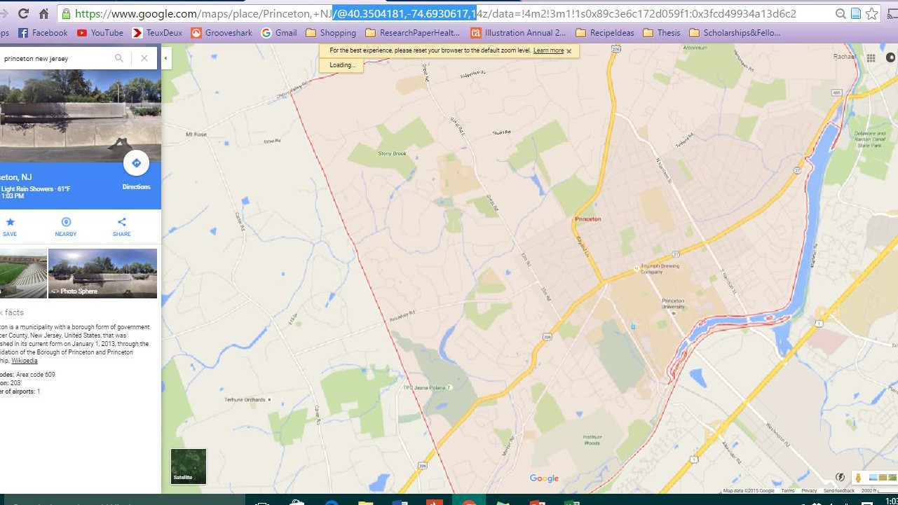
Latitude and Longitude from Google maps

